Slide 1
NUMERIC TESTING
COMP220/285
© University of Liverpool
slide <number>

Slide 2
Numeric functions
Used for
  Financial calculations
  Real time control
    Breaking distance
    Flight control parameters
Often depend on
  Estimated and sampled data
  Statistics
COMP220/185
© University of Liverpool
slide <number>

Slide 3
Testing numeric functions
Two basic categories
  Integer functions
  Real number functions
Discrete integer functions
  Large but finite space
  In theory possible to test every case
Floating point inputs
  Infinite domain mapped to finite address space
COMP220/185
© University of Liverpool
slide <number>

Slide 4
Integer space
8-bit 0-255 or -128 to +127
32-bit 0- 4,294,967,295 or
-2,147,483,648 to 2147483647
64-bit space
0 to 18,446,744,073,709,551,616
COMP220/185
© University of Liverpool
slide <number>

Slide 5
Binary representation recap
For integers representation as follows:
  2^8 2^7 2^6 2^5 2^4 2^3 2^2 2^2 2^0
  128 64 32 16 8 4 2 1
  For fractions
  2^-1 2^-2 2^-3 2^-4 2^-5
  ½ ¼ 1/8 1/32 1/64
COMP220/185
© University of Liverpool
slide <number>

Slide 6
Converting from decimal to binary
For integer part
  10
10 is even so first digit 0 then /2 -> 0
5 is odd so next digit 1 then /2 -> 10
2 is even so next digit 0 then /2 -> 101
1 is odd so next digit 1 then /2 -> 1010
0
So 10₁₀ = 1010₂ binary
COMP220/185
© University of Liverpool
slide <number>

Slide 7
Converting from decimal to binary fractions
0.625 decimal
X 2 = 1.25 is odd, digit is 1 -> 0.1
X 2 = 2.5 is even, digit is 0 -> 0.10
X2 = 5 is odd, digit is 1 -> 0.101
You can also throw away the integer part each time you convert
  0.625 x 2 -> 1.25 Digit = 1 (0.1)
  0.25 x 2 -> 0.5 Digit = 0 (0.10)
  0.5 x 2 -> 1.0 Digit = 1 (0.101)
COMP220/185
© University of Liverpool
slide <number>

Slide 8
In previous examples it’s assumed storage has no loss
0.15625 stored in 4-bit storage
0.15625 x 2 = 0.3125 -> 0.0
0.3125 x 2 = 0.625 -> 0.00
0.625 x 2 = 1.25 -> 0.001
0.25 x 2 = 0.5 -> 0.0010
0.5 x 2 = 1.0 -> 0.00101
Stored in 4-bits = 0.0010 = 0.125
Loss of precision = 0.15625-0.125 =
0.03125 or 20% (loss from original)
COMP220/185
© University of Liverpool
slide <number>

Slide 9
Precision loss
Some numbers cannot be stored with perfect precision in binary
Convert 0.2
0.2 x 2 = 0.4 -> 0.0
0.4 x 2 = 0.8 -> 0.00
0.8 x 2 = 1.6 -> 0.001
0.6 x 2 = 1.2 -> 0.0011
0.2 x 2 = 0.4 -> 0.00110 (start again..)
0.4 x 2 = 0.8 -> 0.001100
0.8 x 2 = 1.6 -> 0.0011001
COMP220/185
© University of Liverpool
slide <number>

Slide 10
Precision loss 0.2
If storing in 10-bits (fixed point)
0.00110011001100110011001100110011001100110011
Get truncated to
0.0011001100₂ =
(½ ^ 3)+ (½ ^4) + (½^7) + (½ ^ 8) = 0.19921875₁₀
So the loss is 0.00078125
or 1.95%
If we round instead
Stored = 0.0011001101₂ = 0.2001953125₁₀
And loss is 0.0001953125 = 0.09%
So round if relevant..
COMP220/185
© University of Liverpool
slide <number>

Slide 11
Rounding in binary
If next digit = 0 then round down (store as truncated)
If next digit = 1 then round up
COMP220/185
© University of Liverpool
slide <number>

Slide 12
Floating point review
Mantissa (fixed point) x 2^exponent
For example if we had 2-bytes floating point
Mantissa = 1.1111111₂ to 0.0000000₂
Exponent = -128 to 127 (2’s complement)
1.0010000 x 2^8 = 100100000₂ =288₁₀
COMP220/185
© University of Liverpool
slide <number>

Slide 13
Normalization
To make sure that precision is maximised, floating point numbers are normalized (leading zeros stripped out)
0.0001000 x 2^5 = 1.0000000 x 2^1
The 1 has floated right (floating point..)
For 0.2
0.0011001100110011001100110011001100110
0.0011001101 x 2^0 = 1.1001101 x 2-3
Notice we get 3-extra sig bits by dropping
0.00 from storage
COMP220/185
© University of Liverpool
slide <number>

Slide 14
Floating point review
Mantissa x 2^exponent
Implications
  Mantissa is fixed size in decimal points
  So worst error is proportional to exponent size
  e.g. 8-bits, smallest number is (½)^8
  As the exponent increases the error increases
COMP220/185
© University of Liverpool
slide <number>

Slide 15
Issues for calculations
Looking at the following statement
  A = B – C;
B !=C → B-C !=0 → A !=0
If B is very close to C, A will be very small
If A cannot be stored as non-zero then this is called underflow
COMP220/185
© University of Liverpool
slide <number>

Slide 16
Overflow
If A+B > Largest number storable
→ Overflow
But overflow != infinity but is returned the same in IEEE 754
Note 1/0 = Infinity
If A very large and B very small
B is de-normalized before subtraction
Possible after de-normalization
  A-B = A (even if B!=0)
COMP220/185
© University of Liverpool
slide <number>

Slide 17
Floating point issues
Imagine we have 5 bit exponent range -16 to +15
Normalization
  0.00001 x 2^-10
  Represented as
  1 x 2^-15
If number is too small result will be de-normalized
  0.0000001x 2^-10
  Normalizes to 1x2^-17 (overflow exponent)
  So we can only go to 0.01x 2^-10
In IEEE the denormalised format is
  0.m x 2^exp (where exp=-126 or -1022)
  Denormalized storage generally means loss of expected precision
COMP220/185
© University of Liverpool
slide <number>

Slide 18
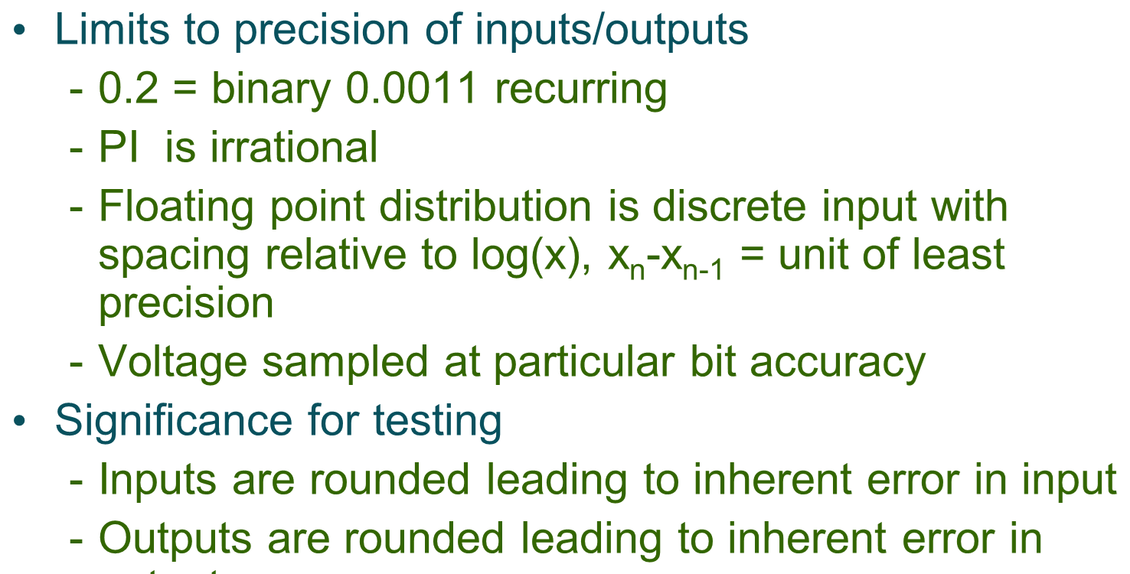
Testing and errors
COMP220/185
© University of Liverpool
slide <number>

Slide 19
Testing and errors
Limits to precision of inputs/outputs
  0.2 = 0.11 recurring
  PI irrational
  Floating point distribution is discrete input with spacing relative to logx
  Voltage sampled at a particular bit accuracy
Significance for testing
  Inputs are rounded leading to error on input
  Outputs are rounded leader to error when storing or returning output
COMP220/185
© University of Liverpool
slide <number>

Slide 20
Unit of least precision
The smallest amount a number can be changed by in a given representation
For int long etc ULP = 1
For fixed point with 3-binary fraction digits ULP = ½ ^ 3
For floating point ULP changes with the number, small numbers have small ULP large numbers have large ULP
COMP220/185
© University of Liverpool
slide <number>

Slide 21
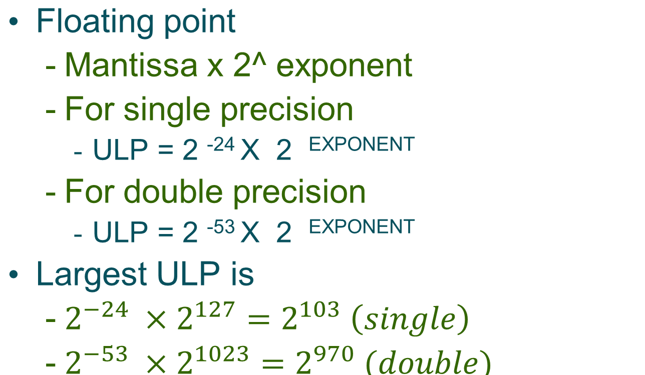
Floating point distribution
COMP220/185
© University of Liverpool
slide <number>

Slide 22

Conditioning number
Error
output
Error
output
error
error
COMP220/185
© University of Liverpool
slide <number>

Slide 23
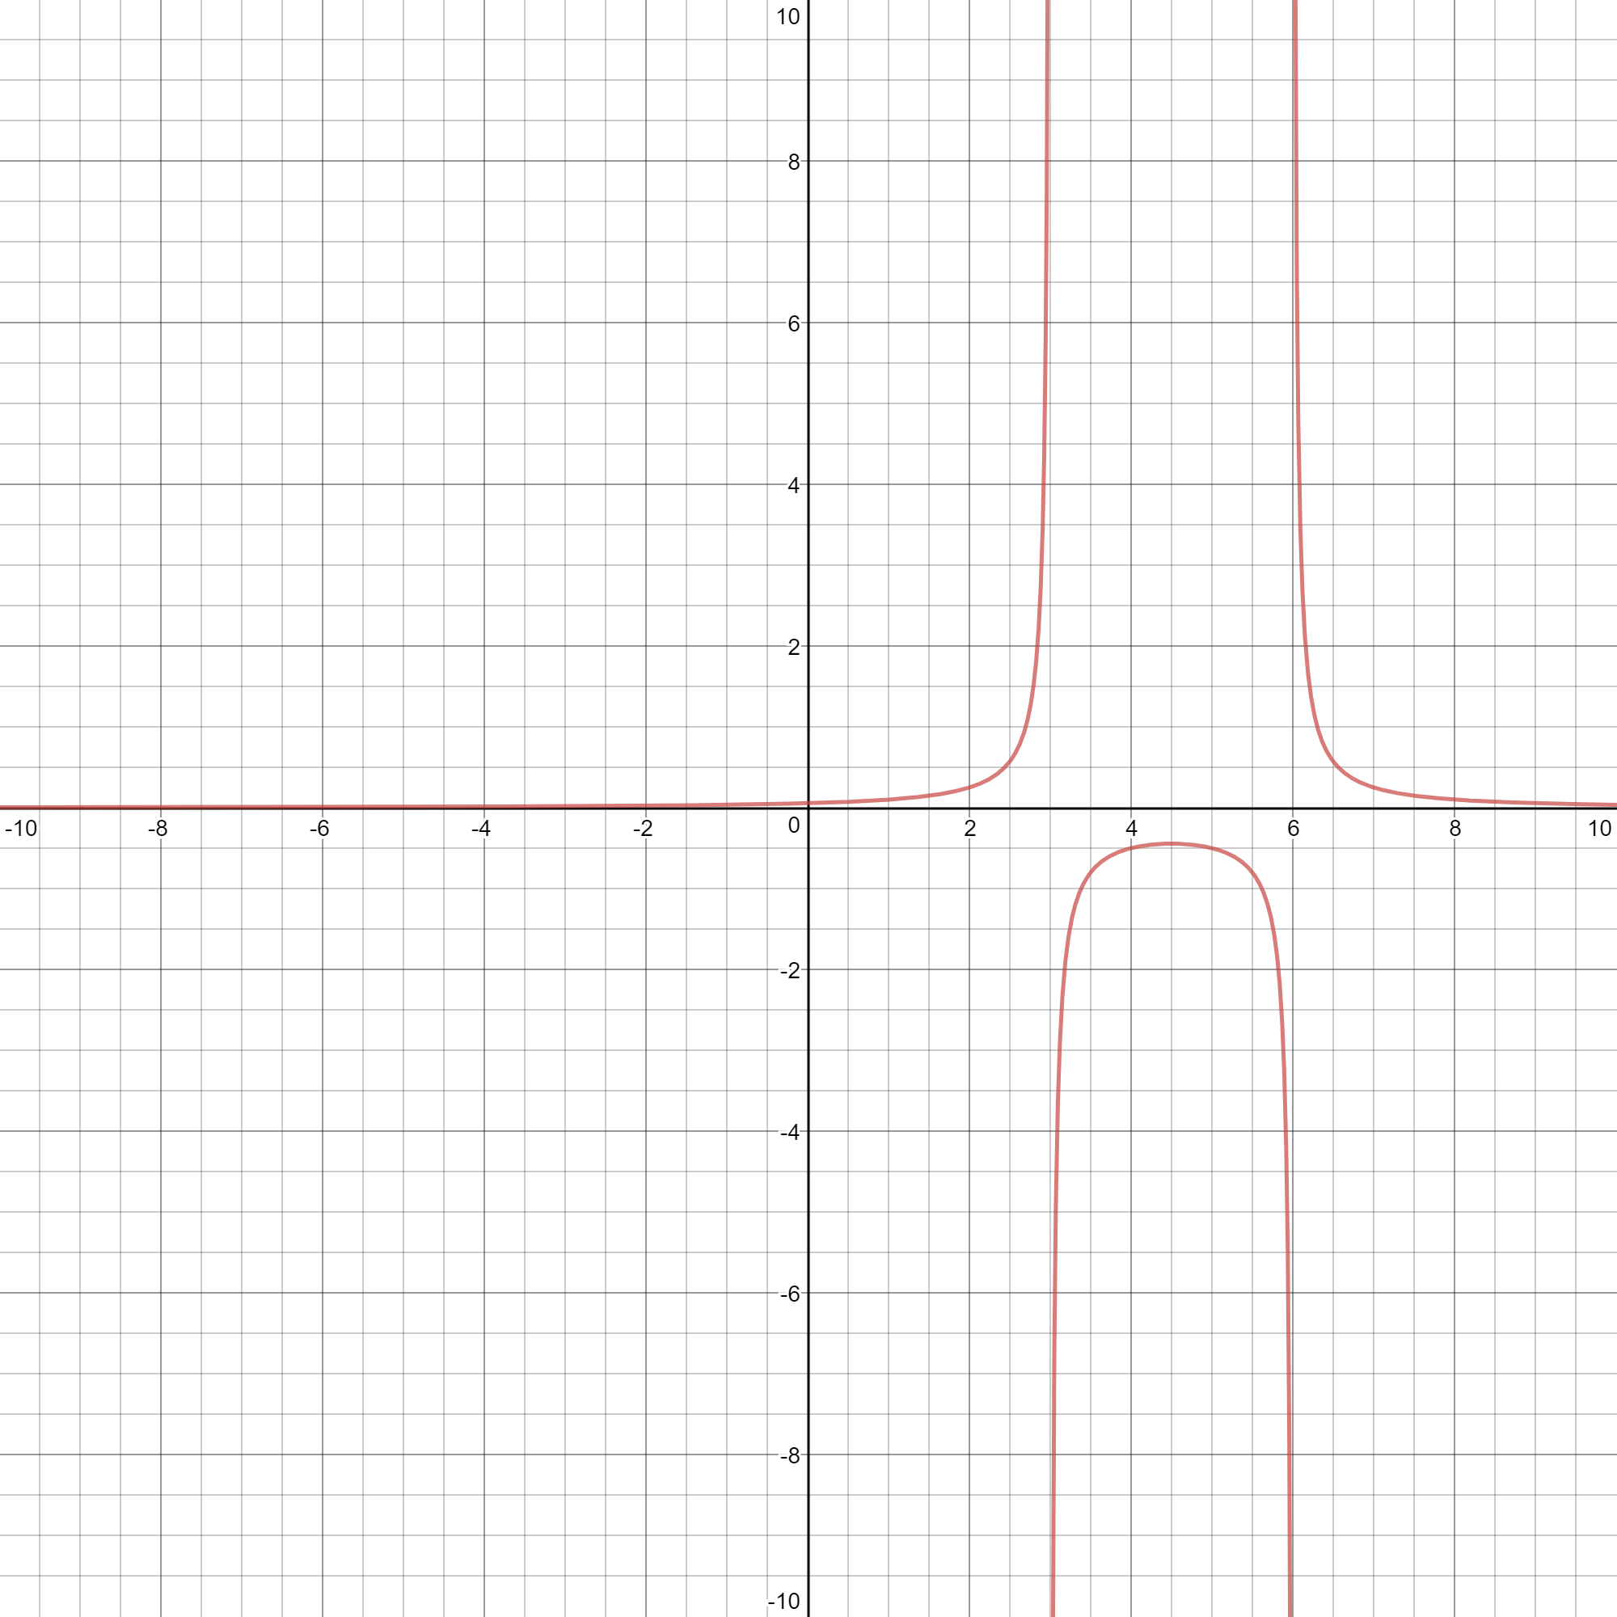
1/(x-2)(x-5) see where the function poorly conditioned
COMP220/185
© University of Liverpool
slide <number>

Slide 24
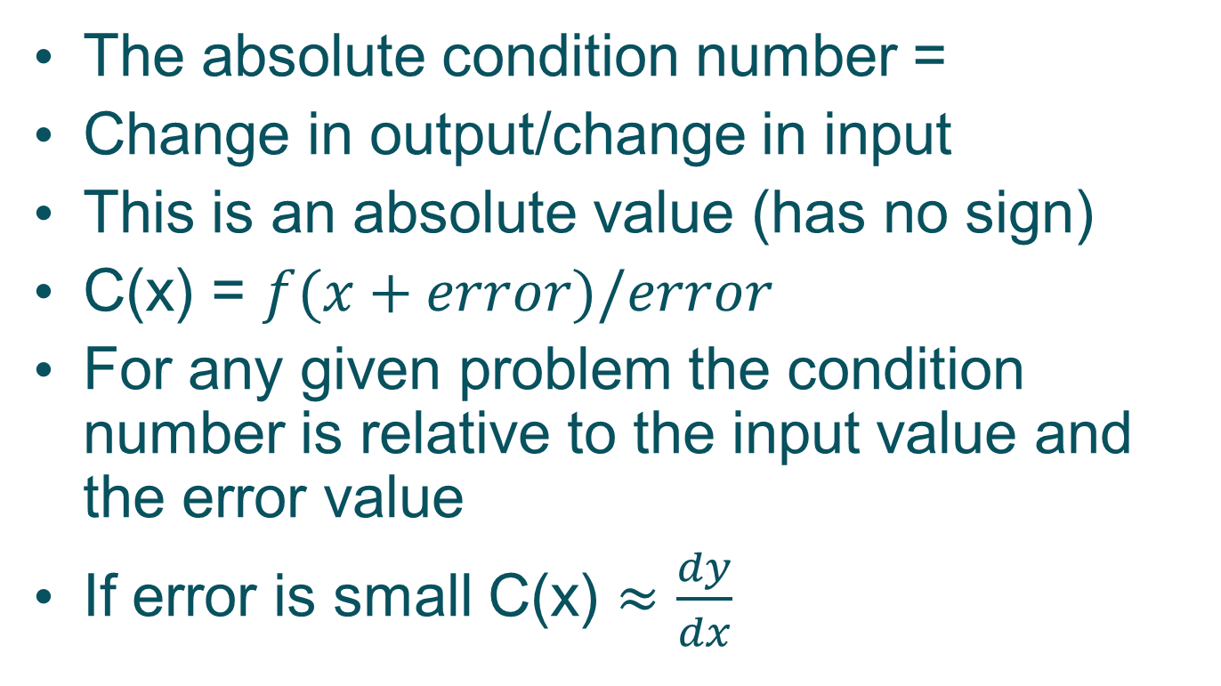
Condition number
COMP220/185
© University of Liverpool
slide <number>

Slide 25
Condition number examples
f(x) = x/(1-x)
X=0.998 error = 0.0001
F(x+error) = 0.9981/(1-0.9981) = 525.3
F(x) = 0.998/(1-0.998) = 499
F(x+error)-F(x) = 26.315789
C(0.998) = 26.315789/0.0001 = 263,158
X=0.999 error = 0.0001
F(x+error) = 0.9991/(1-0.9991) = 1110.1
F(x) = 0.999/(1-0.999) = 999
F(x+error)-F(x) = 111.11
C(0.999) = 111.11 /0.0001 = 1,111,111
COMP220/185
© University of Liverpool
slide <number>

Slide 26
Conditioning implications
Example
  When solving linear equations, the system is called ill-conditioned if a small change in the input causes a large change in solution
So ill-conditioned designs/algorithms can cause
  Instability of output
  Problems with the behaviour of physical systems, imagine electronic circuit, each component can have a range of values due to component tolerances
  Example V = Vin x (5-R) is R value is close to 5 small change in R lead to large change in V
COMP220/185
© University of Liverpool
slide <number>

Slide 27
Conditioning in algorithmic steps
y1=1/(1-x)
y2=y1 x (1-x)*(1+x)
y2 should equal?
y2=(1+x) if x=1 y2=2
but does it?
COMP220/185
© University of Liverpool
slide <number>

Slide 28
Conditioning number and testing
If 1 of your calculation steps has high condition number, this can lead to large errors on result
Possible to have well conditioned function but with poorly conditioned step in algorithm
COMP220/185
© University of Liverpool
slide <number>

Slide 29
Testing numeric functions
| Fcalc(x)- Ftrue(x) | < tolerance
Fcalc(x) is the value produce by our program
To calculate Ftrue we can use a arbitary precision maths package such as GMP
  gmplib.org
But what about the tolerance
COMP220/185
© University of Liverpool
slide <number>

Slide 30
Tolerance
Error in storage = ULP
Function of Unit of Least Precision
  This is dependent on X
Function of the condition number
  The greater the condition number, the greater the effect of loss of precision
In general
  Tolerance <= Cn(x) x ULP
COMP220/185
© University of Liverpool
slide <number>

Slide 31
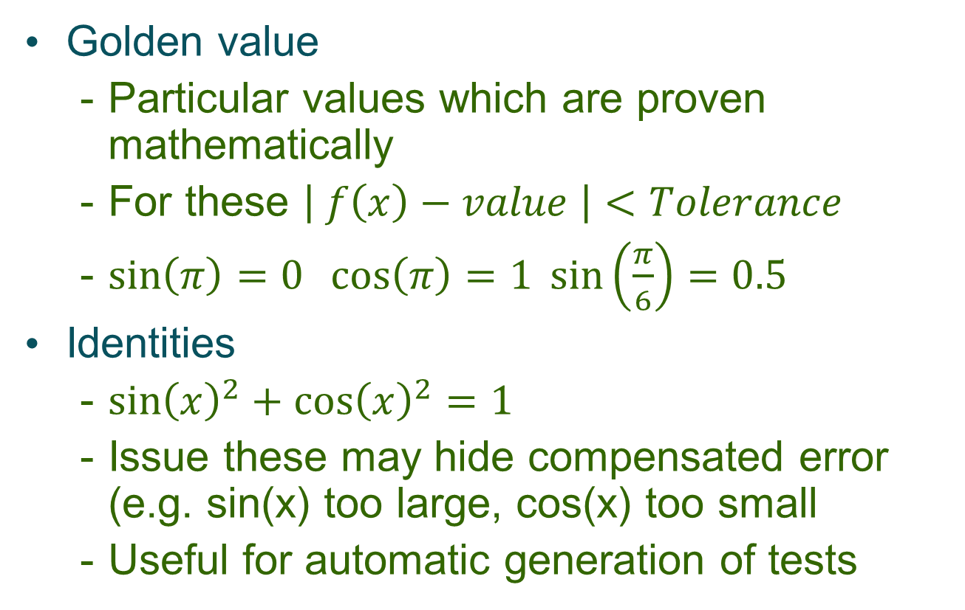
Types of function test
COMP220/185
© University of Liverpool
slide <number>

Slide 32
Numeric test examples
Log10 function
Log10(1)=0 (true for all logs)
Log10(10)=1
Log10(100)=10
Log10(sqrt(10)) = 0.5
Log10(0.1)=-1
Log10(0)=Error
Log10(-1)=Error
COMP220/185
© University of Liverpool
slide <number>

Slide 33
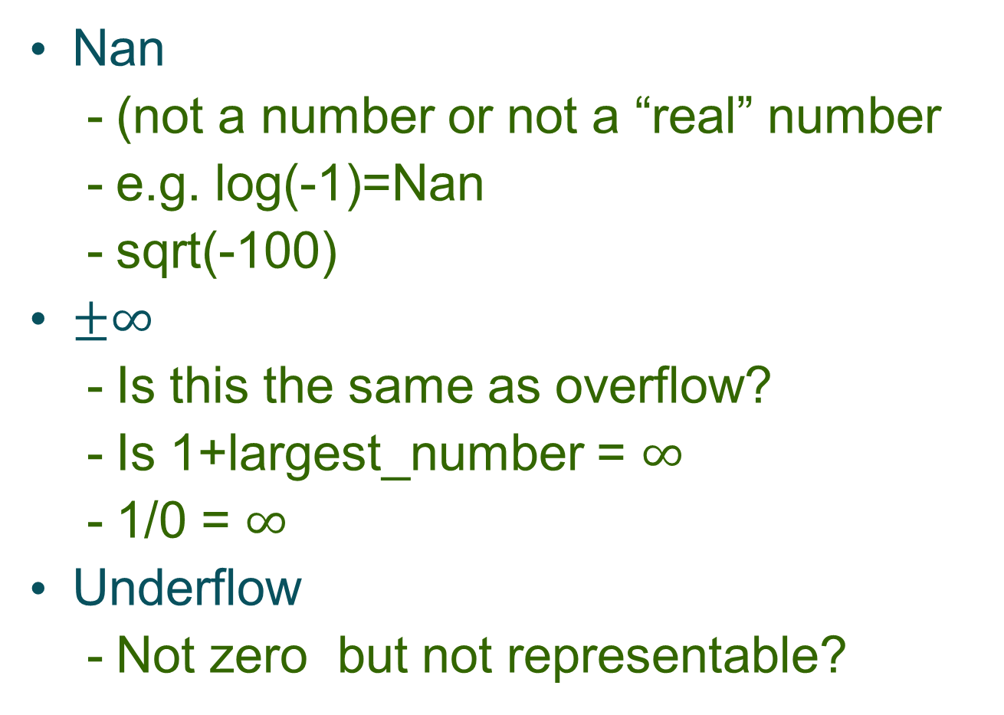
Special values
COMP220/185
© University of Liverpool
slide <number>

Slide 34
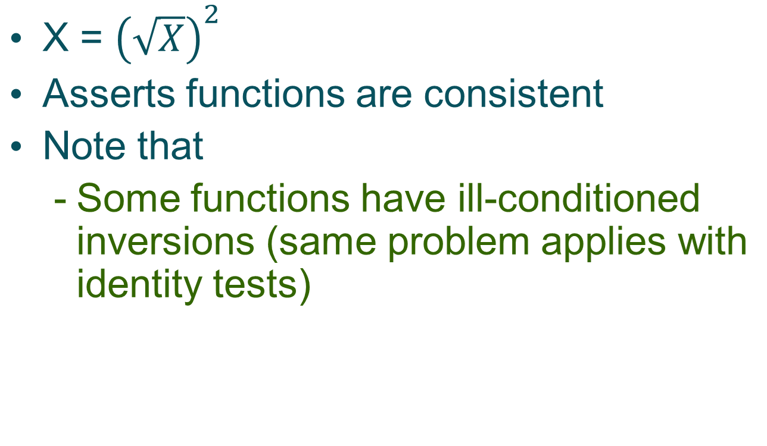
Inverse function tests
COMP220/185
© University of Liverpool
slide <number>
Notes:
<Program Title>

Slide 35
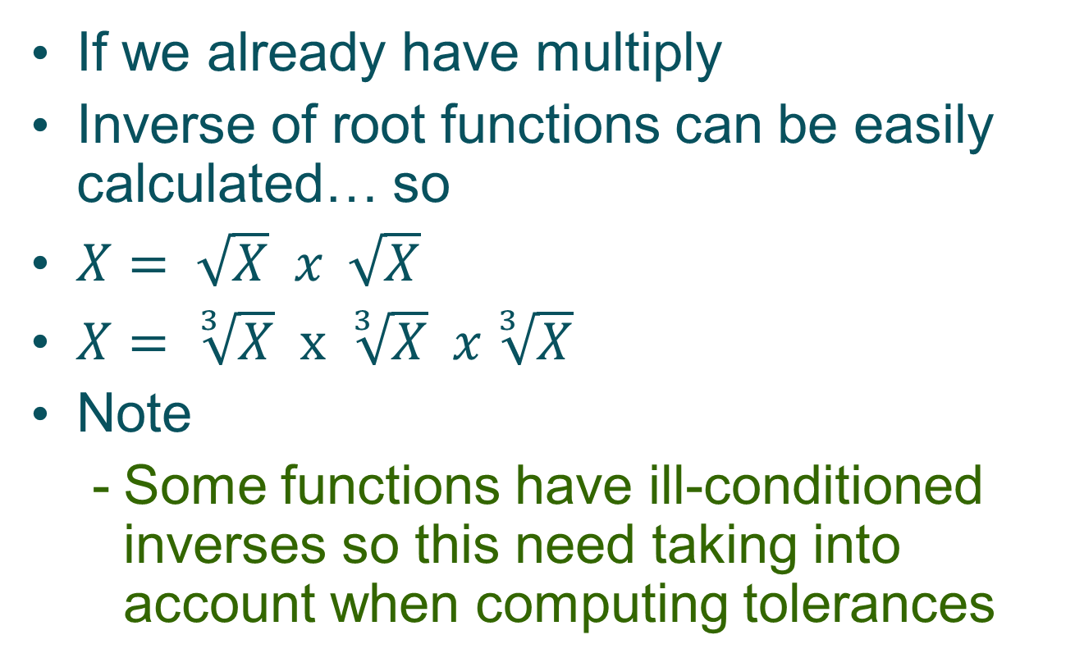
Inverse functions
COMP220/185
© University of Liverpool
slide <number>

Slide 36
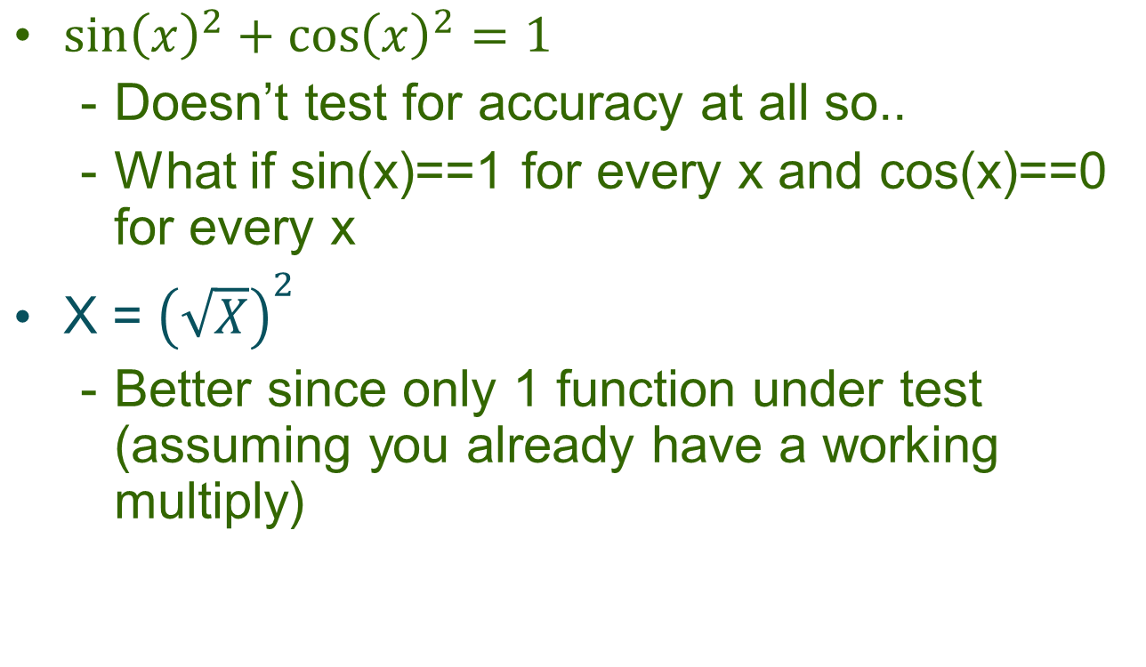
Limitations of identities
COMP220/185
© University of Liverpool
slide <number>

Slide 37
Junit tolerance
public static void assertEquals(double expected, double actual, double delta)
Delta = tolerance
If expected = Nan , actual = Nan then test passes
If expected = infinite, delta not ignored
COMP220/185
© University of Liverpool
slide <number>

Slide 38
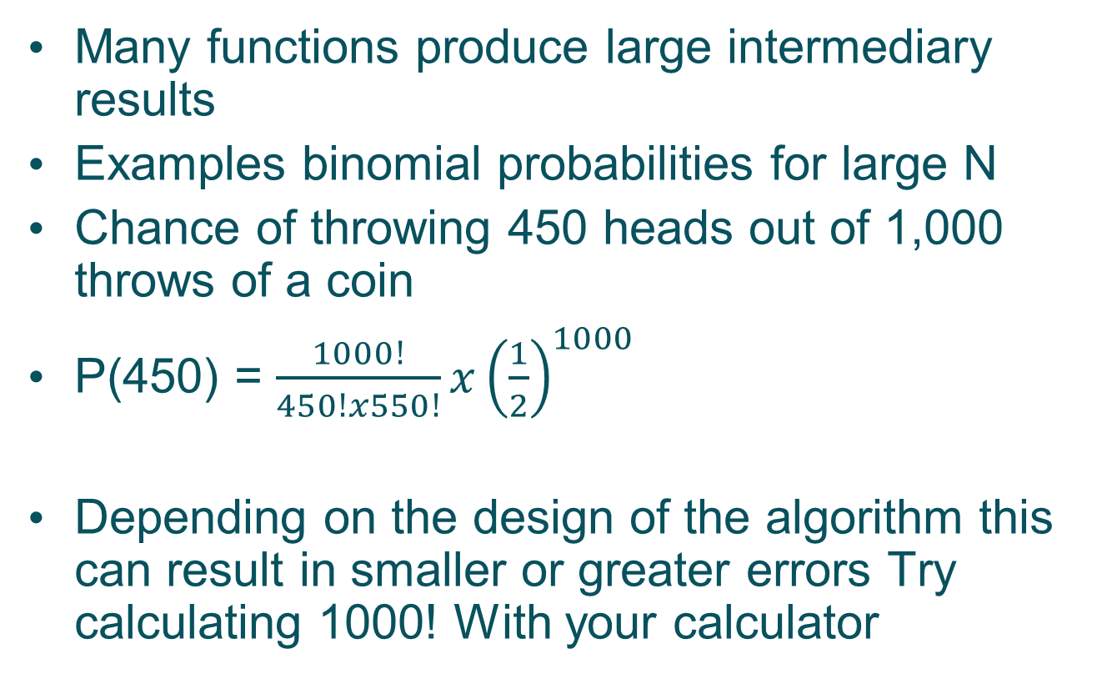
Intermediary results
COMP220/185
© University of Liverpool
slide <number>

Slide 39
Computing chances ill-conditioned
public double coinProb(int n,int c) {
double prob=0.5;
double answer=1.0;
double fact1=factorial(n);
double fact2=factorial(n-c);
double fact3=factorial(c);
answer=(fact1/(fact2*fact3))*(Math.pow(prob, n));
return(answer);
}
COMP220/185
© University of Liverpool
slide <number>

Slide 40
Computing chance adjust algorithm
public double coinProb1(int n,int c) {
double answer=1.0; double prob=0.5; int totalMul=n;
int idx2=1;
for (int idx=n;idx>(n-c);idx--) {
answer=answer*idx;
if (idx2<c+1) {
answer=answer/idx2;
idx2++;
}
while ((answer>1) && (totalMul>0)) {
answer=answer*prob;
totalMul--;
}
}
while(idx2<c+1) {
answer=answer/idx2;idx2++;
}
while (totalMul>0) {
answer=answer*prob;totalMul--;
}
return(answer);
COMP220/185
© University of Liverpool
slide <number>

Slide 41
Back to back testing
Random rnd=new Random(System.currentTimeMillis());
for (int tests=0;tests<20;tests++) {
int n=5+rnd.nextInt(5); // pick random n
int c=rnd.nextInt(n); // pick random c
assertEquals("Back to back test for n="+n+" c="+c,calculator.coinProb(n, c),calculator.coinProb1(n, c),0.00000000001);
}
COMP220/185
© University of Liverpool
slide <number>

Slide 42
Summary
Numeric function testing relies on
  The properties of the function being tested (condition number, argument type)
  Having proper values for
    Correct function output
    Tolerance for the test
COMP220/185
© University of Liverpool
slide <number>

Slide 43
Summary
Functions can
Special values golden values
Linked together to give identities
Be tested using a previously tested inverse function
COMP220/185
© University of Liverpool
slide <number>

Slide 44
Review test
Assume your are storing in 8-bits fixed decimal storage, what will be the error when storing
  0.1
  0.25
  0.3
Assuming you are testing the function log(x-4)
Calculate the tolerance for testing x=3, assuming the error on input = 0.0002
COMP220/185
© University of Liverpool
slide <number>

Slide 45
Produce a set of tests for Log2
Assume you have the Math.pow function
Produce a full range of tests
COMP220/185
© University of Liverpool
slide <number>

